Slide 1

CMSC 137
Data Communications and Networking
Lecture Module
05 - Signal

Slide 2
Module 5: Signal
Rozano S. Maniaol
Lecturer

Slide 3
Introduction
Physical layer moves data in the form of electromagnetic signals across a transmission medium
Data must be changed to a form that transmission media can accept

Slide 4
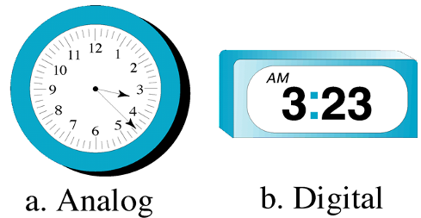
Data
Analog data
  Continuous, e.g human voice
Digital data
  Discrete state, e.g data produced by computers

Slide 5
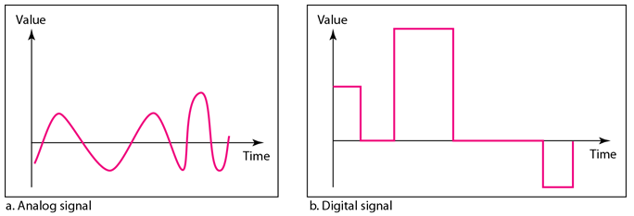
Signal
Analog signal
  Infinitely many levels of intensity over a period of time
Digital signal
  Have a limited number of defined values (ex. 0 and 1)

Slide 6
Periodic and Nonperiodic Signal
Periodic signal
  Completes a pattern within a measurable time frame (period)
  Cycle – completion of one full pattern
  Need less bandwidth
Nonperiodic signal (Aperiodic)
  Changes without exhibiting a pattern or cycle that repeats over time
  Can represent variation in data

Slide 7
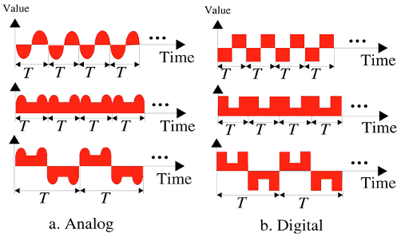
Periodic Signals

Slide 8
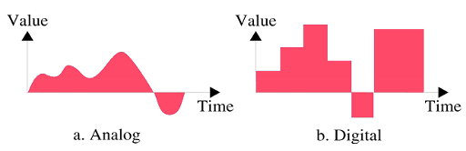
Nonperiodic Signal

Slide 9
In data communications, we commonly use periodic analog signals and nonperiodic digital signals

Slide 10
Analog Signals

Slide 11
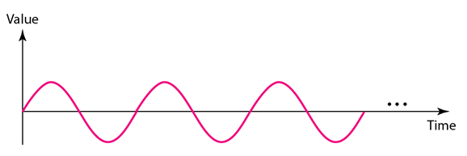
Periodic Analog Signal
Periodic analog signal can be classified as simple or composite
Sine Wave
  Most fundamental form of a periodic analog signal
  Fully described by its peak amplitude, frequency and phase

Slide 12
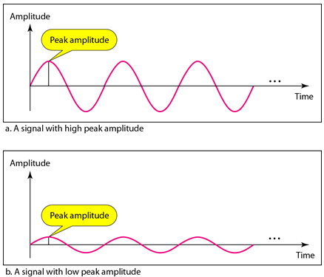
Peak Amplitude
Absolute value of a signal's highest intensity proportional to the energy it carries

Slide 13
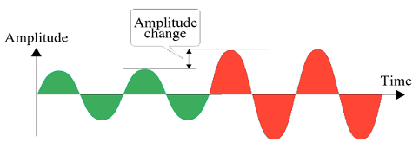
Amplitude change

Slide 14

Frequency
Period (T)
  Amount of time in seconds a signal needs to complete 1 cycle.
Frequency (f)
  Number of periods (or cycles) in 1 second, hertz
  Measure of the rate of change of a signal with respect to time
T and f are inverse of each other:

Slide 15
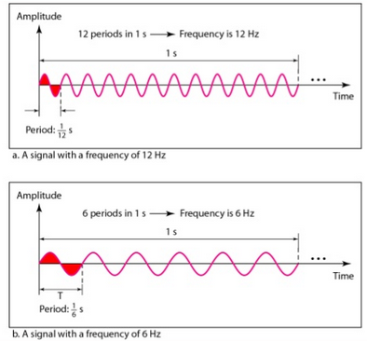
Frequency

Slide 16
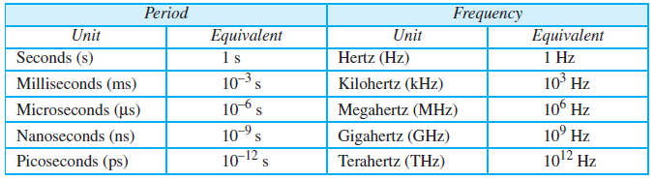
Frequency

Slide 17
Frequency
Change in a short span of time means high frequency
Change over a long span of time means low frequency
If a signal does not change at all, its frequency is zero
If a signal changes instantaneously, its frequency is infinite

Slide 18

Frequency change

Slide 19
Phase
Position of waveform relative to time 0
The amount of shift in the time axis (x-axis)
Measured in degrees or radians

Slide 20
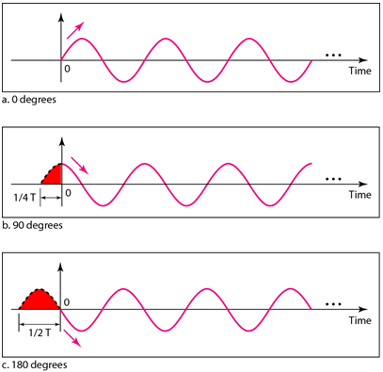
Phase

Slide 21
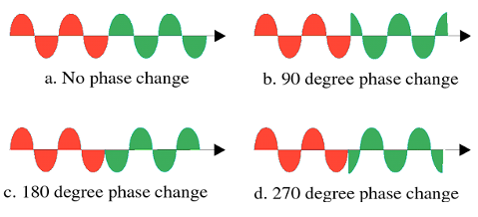
Phase change

Slide 22

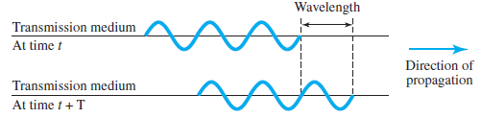
Wavelength
Distance a simple signal can travel in one period (λ)
Binds T or f of a simple sine wave to the propagation speed of the medium
where c = propagation of light: 3 x 10⁸ m/s
Unit is micrometers (microns)

Slide 23
Time and Frequency Domain
Time-domain plot shows changes in signal amplitude with respect to time
Frequency-domain plot is concerned with only the peak value and the frequency
A complete sine wave in the time domain can be represented by one single spike in the frequency domain
The position of the spike shows the frequency; its height shows the peak amplitude

Slide 24
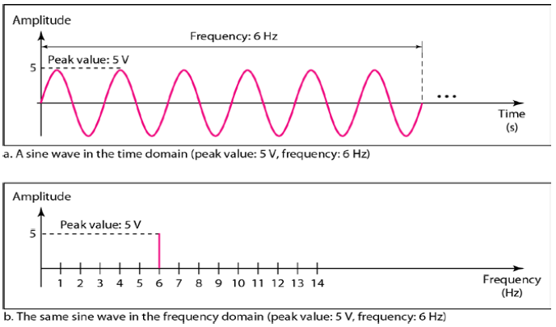
Time and Frequency Domain

Slide 25
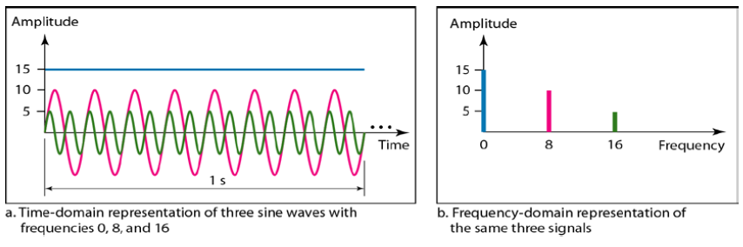
Time and Frequency Domain

Slide 26
Composite Signals
Made up of many simple sine waves
Jean-Baptiste Fourier - any composite signal is actually a combination of simple sine waves with different frequencies, amplitude, and phases
If the composite signal is periodic, the decomposition gives a series of signals with discrete frequencies
If the composite signal is nonperiodic, the decomposition gives a combination of sine waves with continuous frequencies

Slide 27
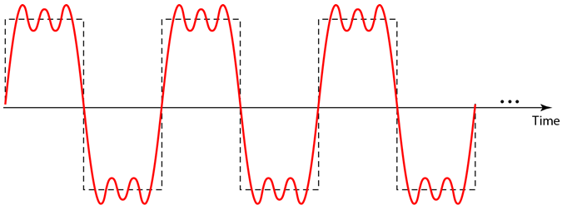
Periodic Composite Signal

Slide 28
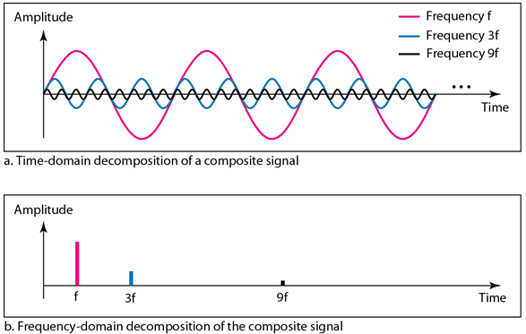
Periodic Composite Signal

Slide 29
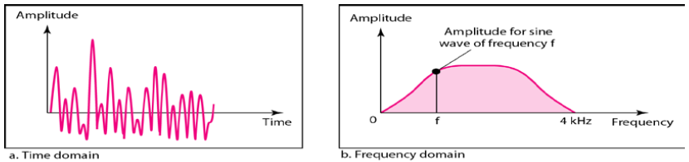
Nonperiodic Composite Signal

Slide 30
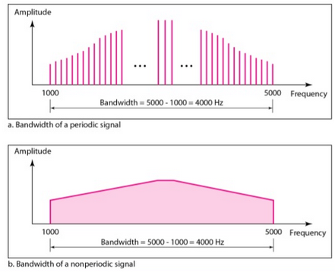
Bandwidth
Range of frequencies contained in a composite signal
Ex. Given a composite signal with frequencies between 1000Hz and 5000Hz
  Bandwidth = 5000 – 1000
  = 4000Hz

Slide 31
Digital Signal

Slide 32
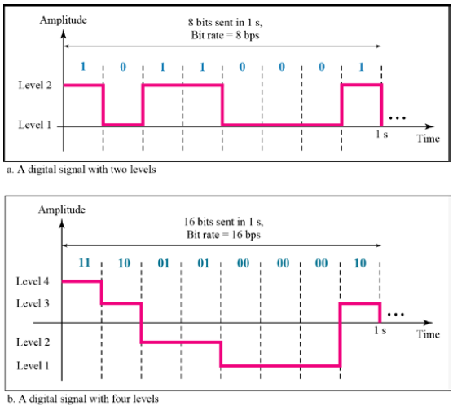
Digital Signal
A “1” can be encoded as a positive voltage and a “0” as zero voltage
A digital signal can have more than two levels
  We can send more than 1 bit for each level
If a signal has L levels, each level needs log₂ L bits
  Ex. if digital signal has eight levels
  log₂ 8 = 3

Slide 33
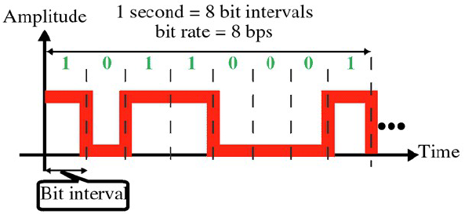
Bit Rate
Most digital signals are nonperiodic
Bit rate – number of bits sent in 1 second, expressed as bits per second (bps)
Bit interval = 1 / bit rate

Slide 34
Bit Length
Distance one bit occupies on the transmission medium

Slide 35
Digital Signal as a Composite Signal
Based on Fourier analysis, a digital signal is a composite analog signal with infinite bandwidth
In a time domain plot, it comprises connected vertical and horizontal line segments
  Vertical line means a frequency of infinity
  Horizontal line means a frequency of zero
Going from frequency of zero to frequency of infinity (and vice versa) implies all frequencies in between are part of the domain

Slide 36
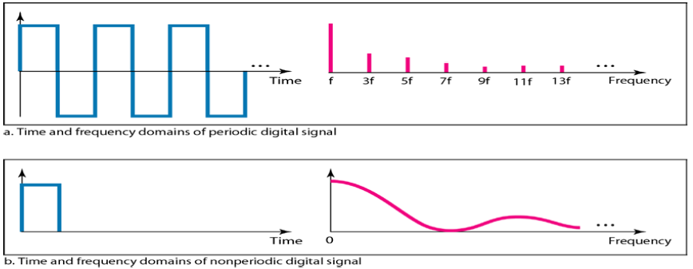
Digital Signal as a Composite Signal

Slide 37
Transmission of Digital Signals
How can we send a digital signal from point A to point B?
Data communications use nonperiodic digital signal
  A digital signal is a composite analog signal with an infinite bandwidth
Two approaches: baseband and broadband

Slide 38

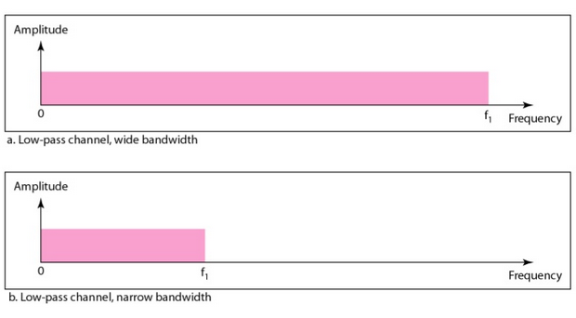
Baseband Transmission
Sends a digital signal without changing it to analog signal
Requires a dedicated low-pass channel, a channel with a bandwidth that starts from zero
Bandwidth extending from DC to some upper frequency limit

Slide 39
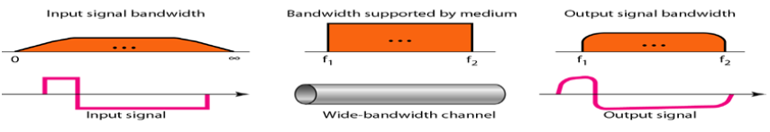
Low-Pass Channel with Wide Bandwidth
To preserves the shape of the digital signal, the entire spectrum should be sent

Slide 40
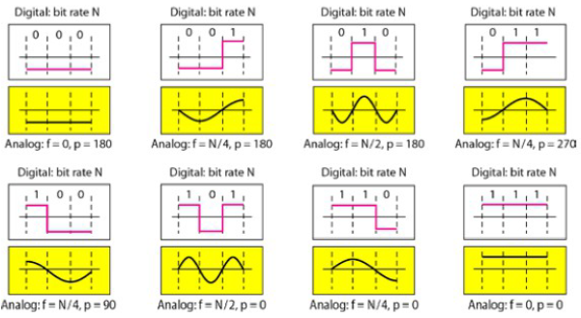
Low-Pass Channel with Narrow Bandwidth
Approximate the digital signal with an analog signal
Rough approximation
In baseband transmission, the required bandwidth is proportional to the bit rate; if we need to send bits faster, we need more bandwidth

Slide 41
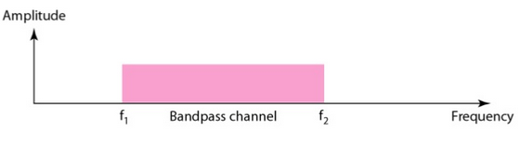
Broadband Transmission
Changes the digital signal to analog signal for transmission (also called modulation)
Allows the use of bandpass channel – a channel with a bandwidth that does not start from zero
Bandwidth covering a range of frequencies

Slide 42
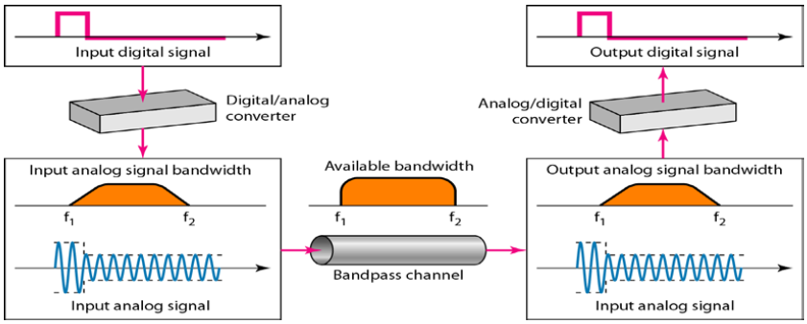
Broadband Transmission

Slide 43
References
Forouzan, B.A. 2013. Data Communications and Networking, 5th Ed. McGraw-Hill, New York.

